Slide 1
TEXT

Slide 2
Text-Align
Body {
text-align: center;
}
h2 {
text-align: left;
}
h3 {
text-align: right;
}
h4 {
text-align: justify;
}

Slide 3
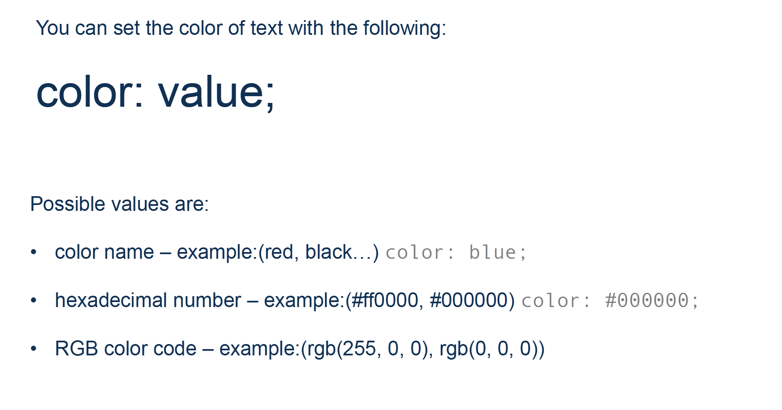
Text-color
h1 {
color: red;
}

Slide 4
Text-Decoration
The text-decoration property is used to set or remove decorations from text.
h1 {
text-decoration: overline;
}
h2 {
text-decoration: line-through;
}
h3 {
text-decoration: underline;
}

Slide 5
Text Transformation
The text-transform property is used to specify uppercase and lowercase letters in a text.
body {
text-transform: uppercase;
(lowercase / capitalize)
}

Slide 6
Text Indentation
The text-indent property is used to specify the indentation of the first line of a text
p {
text-indent: 50px;
}

Slide 7
Letter Spacing
The letter-spacing property is used to specify the space between the characters in a text
body {
letter-spacing: 3px;
}
body {
letter-spacing: -3px;
}

Slide 8
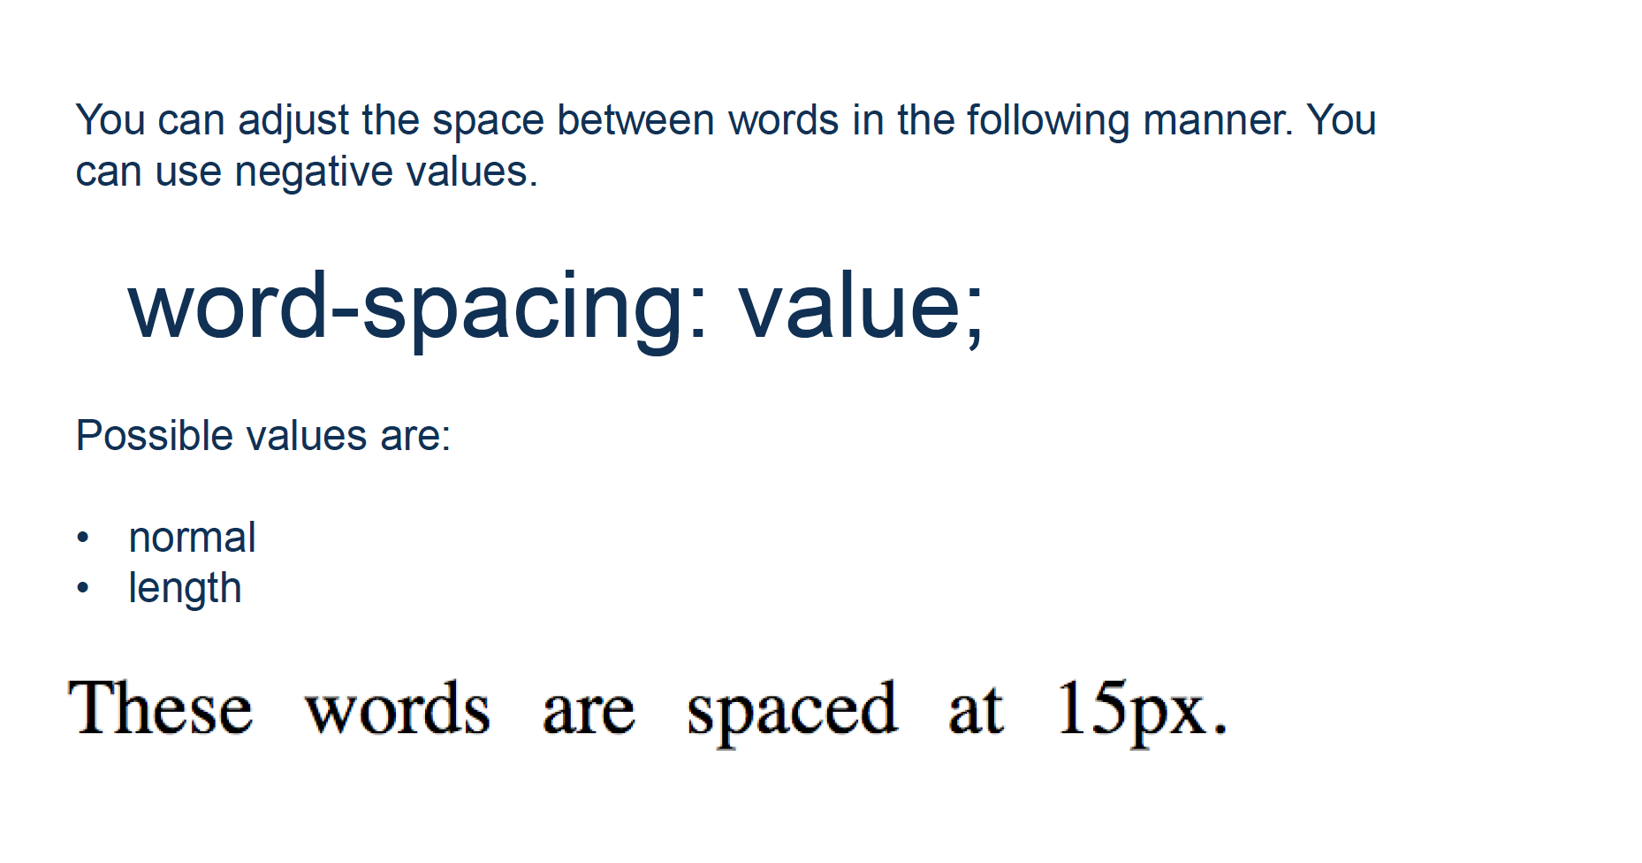
word-spacing

Slide 9
Line Height
The line-height property is used to specify the space between lines
p.small {
line-height: 0.8;
}
p.big {
line-height: 1.8;
}

Slide 10
Text-Direction
The line-height property is used to specify the space between lines
p.small {
direction:rtl;
}
p.small {
direction:rtl;
unicode-bidi: bidi-override;
}

Slide 11
Text Shadow
The text-shadow property adds shadow to text.
The following example specifies the position of the horizontal shadow (3px), the position of the vertical shadow (2px) and the color of the shadow (red):
p.small {
text-shadow: 3px 2px red;
}

Slide 12
Shadow
p.small {
text-shadow: 3px 2px red;
}
p.small {
box-shadow: 13px 12px 10px red;
}

